Slide 1





Zainab AlSaeed
Microsoft Student Partner
Bahrain Polytechnic Graduate, Management Information Systems
C# Programmer
Notes:
Background placeholder: After choosing your image, Right click on the image -> Send to back -> Click on send to back

Slide 2



Tell me about yourself..
What is your name?
How old are you?
Are you in school or collage? Which year?
Do you have any experience in programming? If yes, which language?
Random fact about yourself

Slide 3
What are we going to do here?
1
Learn how to code
2
3
4
Share ideas and knowledge
Develop mobile application
Have fun! ☺

Slide 4
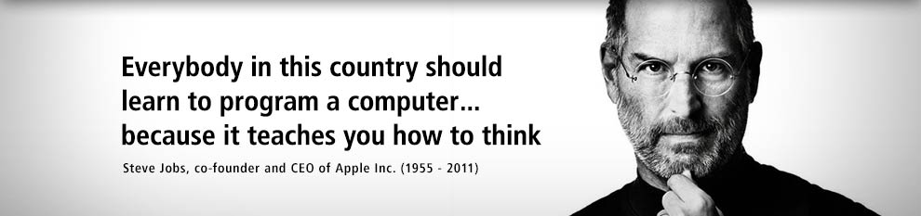
Quote of the day…

Slide 5
Let’s Code in C#!
Session 1
World One Powerful Presentation Template
Notes:
Roboto Condensed font

Slide 6

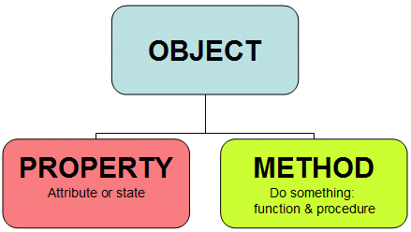
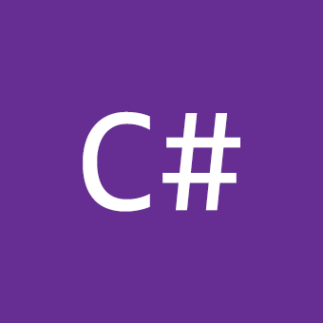
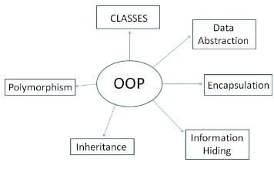
Timeline
What is programming?
What is OOP?
What is C#?
Basic Concepts

Slide 7

Algorithms
In order to solve a problem using a computer, you need to come up with one or more algorithms.
What is an Algorithm?
A step-by-step description of how to accomplish a task
What an Algorithm must be?
Precise: specified in a clear an unambiguous way
Effective: capable of being carried out

Slide 8

What is programming?
Programming involves expressing an algorithm in a form that a computer can interpret.
Developing set of instructions to enable a computer to do a certain task.

Slide 9





Examples of programming languages

Slide 10
Types of programming languages
Procedural
Declarative
Data-Oriented
Scripting
Java
C#
C++
PHP
Python
Prolog
SQL
dBase
Perl
Ruby
JavaScript
Bash

Slide 11
What is Object-Oriented Programming?
A programming model based on the concept of "objects", which are data structures that contain data, in the form of fields, often known as attributes; and code, in the form of procedures, often known as methods.

Slide 12

Attributes
Name
Methods
Walk
Color
Weight
Age
Sleep
Eat

Slide 13
What is C#?
An object-oriented programming language developed by Microsoft in 2000, designed to work with Microsoft's .Net platform using .Net framework libraries.

Slide 14
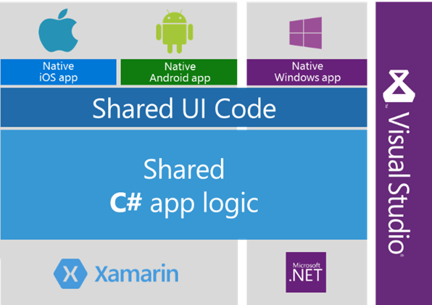
Why C#?
Notes:
5.Ease-to-development, The rich class library makes many functions easy to be implemented.
6.Cross-platform. you application will run well only if the machine installed the .NET framework.

Slide 15
What is an IDE?
Integrated Development Environment (IDE) is an application that help you to develop programs
With IDEs we can:
Use its built-in text editor to write codes
Instruct the IDE to compile the code
Instruct the IDE to run the program
Debug the program using the IDE’s debugging tools

Slide 16

Visual Studio 2015
https://www.visualstudio.com/

Slide 17
Basic concepts
01
02
03
04
- Classes
- Attributes
- Methods
- Objects
- Variables
- Initializing variables
- Data type
- Operators (Logical and Arithmetic)
- Comparison
- String concatenation
- Increment and decrement
- Flow control
- If statements
- Loops
- Comments (single and multiline)
Basic structure
Variables
Operators
Flow Control

Slide 18
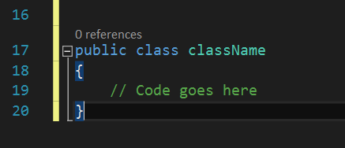
Classes
In C#, all programs consist of one or more classes.
For now, we will write our code in a single class
A class is like the container of your code

Slide 19
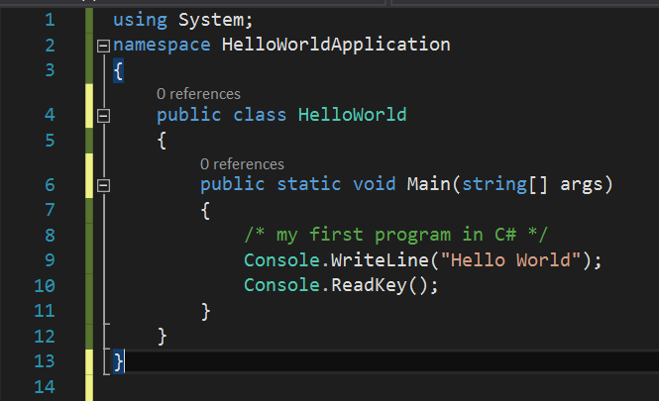
Creating Hello World Application
A Hello World program in C# program consists of the following parts:
Namespace declaration
A class
A Main method
Comments
Statements and Expressions

Slide 20
Methods
A method is a collection of instructions that perform some action or computation.
Every C# program must include a method called main.
The main method contains the instructions that will be executed first when the program is run
Notes:
• Notes:
• the main method always begins with the same header: public static void main(String[] args)
• the code inside the method is enclosed in curly braces
• each statement typically ends with a semi-colon
• the statements are executed sequentiall

Slide 21
Notes
It is worth to note the following points:
C# is case sensitive.
All statements and expression must end with a semicolon (;).
The program execution starts at the Main method.

Slide 22
Data Types
Basically, datatype is the forms data and information can be stored and used in the machine.
These are some of the data types can be used in C#:
Data Type Name | Example
Integer | 1, 5, -6, 1000
Double | 3.65, -34.66, 0.443. 3.11
String | Hello there, Hi, admin123, Zainab AlSaeed
Boolean | True, false

Slide 23
Variables
Variables are temporary place holders that do not have fixed values. Their values can be changed while writing the code or while running the application.
Variables in C# can have these two main forms:
Datatype variableName;
Datatype variableName = value;

Slide 24
Variables
The syntax:
Data Type
Variable Name
Int
Bool
Double
String
firstName
mobileNumber
age
<data_type> <variable_name> = value;
Example:
int d = 3, f = 5;
bool flag = true;
double pi = 3.14159;
string firstName = ‘Zainab';

Slide 25
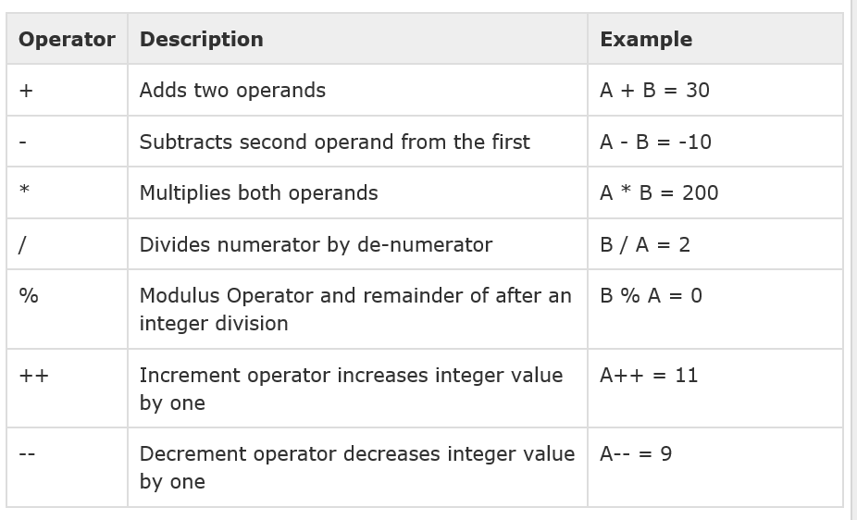

Slide 26
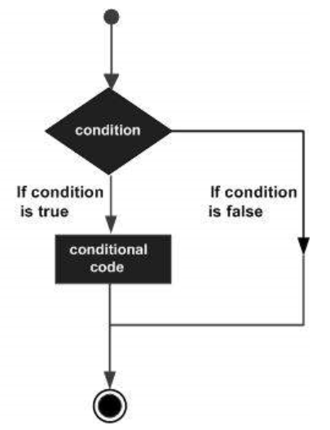
Flow Control
The syntax:
If (<condition>) { //do something}
else {//do something}
Example:
if (grade >= 90) { Console.WriteLine(“A”); }
else { Console.WriteLine(“You have to study hard!”); }

Slide 27
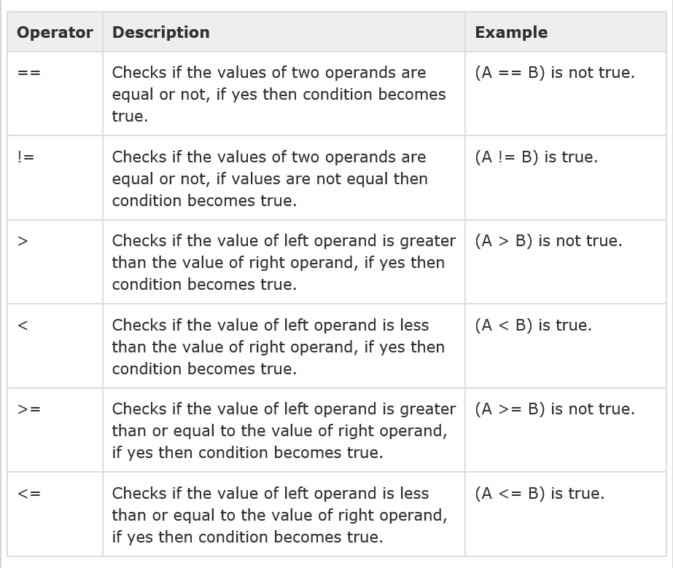

Slide 28
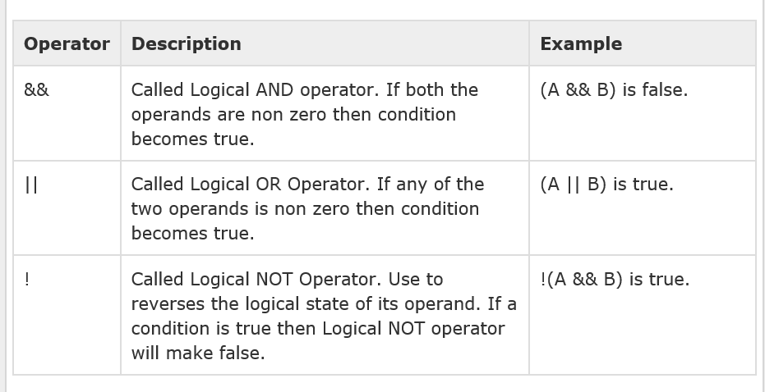
If statements with two or more conditions

Slide 29
Questions?

Slide 30
Useful Links
Links:
https://mva.microsoft.com/training-topics/c-app-development#!jobf=Developer&lang=1033
http://www.tutorialspoint.com/csharp/
https://msdn.microsoft.com/en-us/library/aa288436(v=vs.71).aspx
Social Media:
zainab.alsaeed94@gmail.com
https://bh.linkedin.com/in/zainabalsaeed

